Slide 1
ECON 620 Development Economics Rudolph Monsio Bropleh, Ph.D. School of Graduate & Professional Studies
Lecture Notes on INCOME

Slide 2
Generating Income is essential for economic growth and development.
Job creation is one of the most important economic activities in any society.
When jobs are created, goods and services are produced and income is generated, fueling economic development.
Economic development helps poverty alleviation, malnutrition, inequality, and healthcare.

Slide 3
Earning Income is good for the microeconomy and the macroeconomy.
Income facilitates Human Development, improving people’s abilities and earnings potential.
Basic needs like shelter, food and clothing are met.

Slide 4
Income vs. Development
In rich countries: development and income growth are seen as similar
E.g., think about urban development projects
A lot of things correlate with income
Life expectancy is higher in the US than Malawi
But most development economists would say development is different from income growth
…though it’s hard to have development without income growth

Slide 5
Income and Development (Don’t confuse the two!)
Economic development involves many outcomes:
Income growth, poverty alleviation, inequality, and human welfare.
Remember this:
Income growth and development are different things, yet very related.
It’s hard to have development without growth.

Slide 6
What is INCOME?
Earnings from the production of goods and services.
Money received through income security programs like pension, disability, etc.
Earnings through interest payments and investments.

Slide 7
What is Per-capita Income and why does it matter?
Take the GDP (Gross Domestic Product)
Divide by the population
What everyone would have if income were perfectly equally distributed
One measure of welfare (and development)

Slide 8
What is Growth?
Growth: Rise in national or per-capita income and production (Ch. 6)
Gross Domestic Product (GDP; same as National Income)
Add up value of all final goods and services produced in a country then sold
Value at market prices
Alternatively, add up the cost of all factor inputs (Capital, Labor, Land), called Value Added.
GDP at factor cost

Slide 9
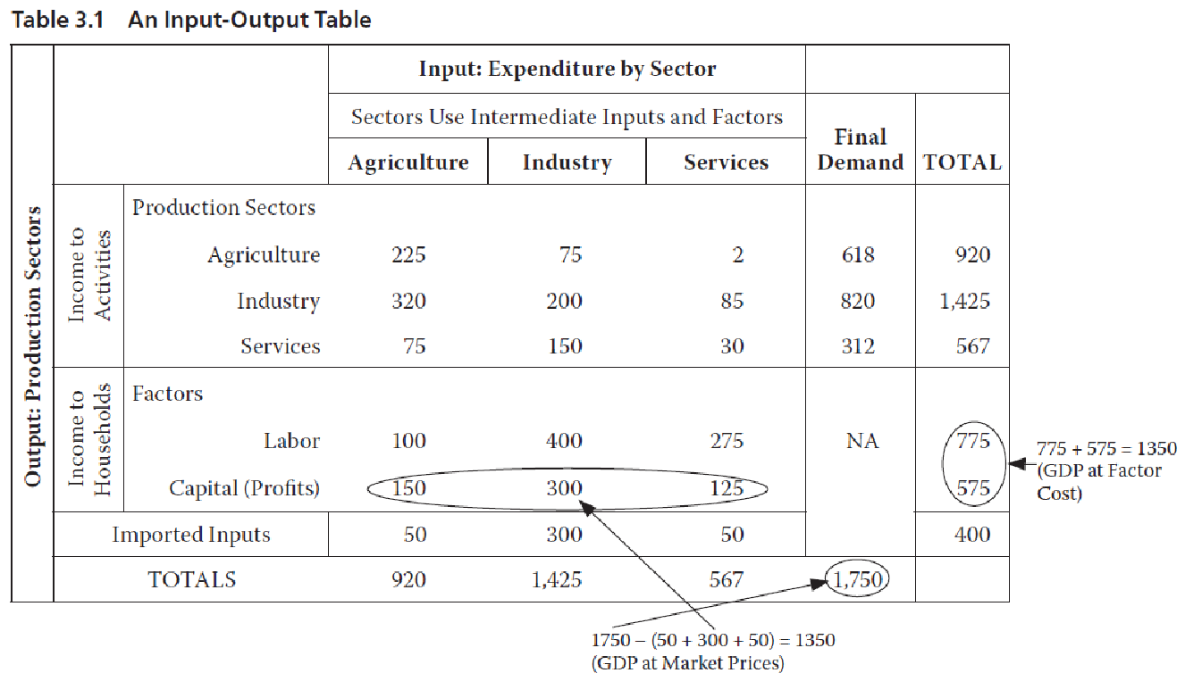
Two Ways to Calculate GDP with Input-Output Accounting

Slide 10
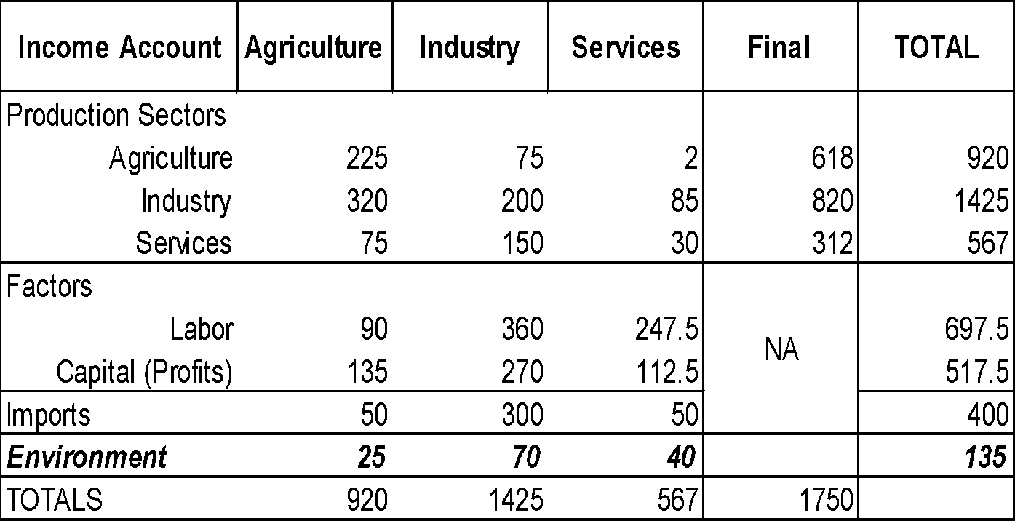
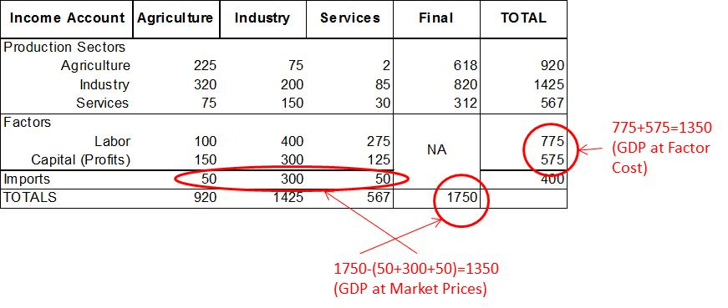
Green Accounting
697.5+517.5=1,215(<1,350)
Standard Accounting

Slide 11
GNP vs. GDP
Gross National Product: Like GDP but includes the value the country’s citizens produce outside the country’s borders
Philippines: GDP is ~6% lower than GNP, because it doesn’t count income of Philippine migrants working abroad
If Philippine person works in Malaysia, the value of output she produces counts in the Philippines’ GNP but not its GDP.
It counts in Malaysia’s GDP but not GNP
We often use GDP; it usually doesn’t matter much

Slide 12
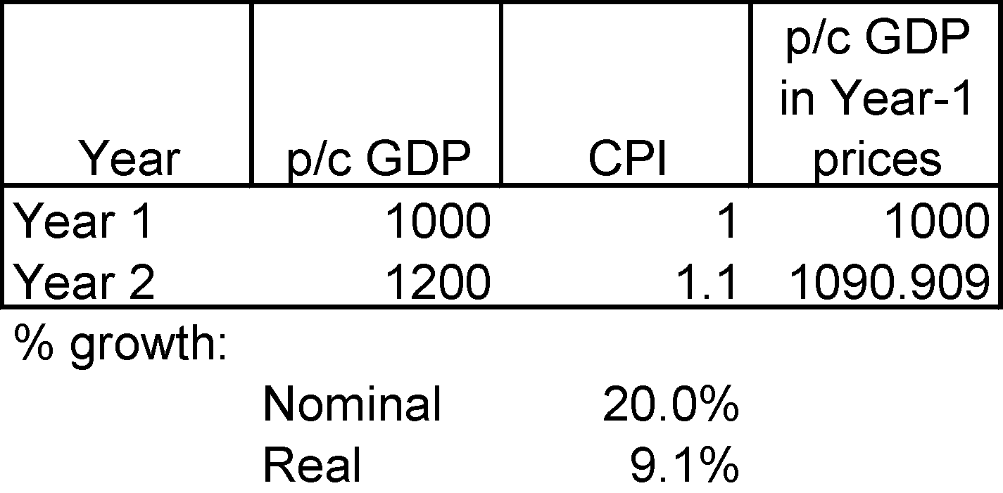
Real vs. Nominal GDP
Real means “adjusted for inflation”
Very important for comparing a country’s changes in income over time:

Slide 13
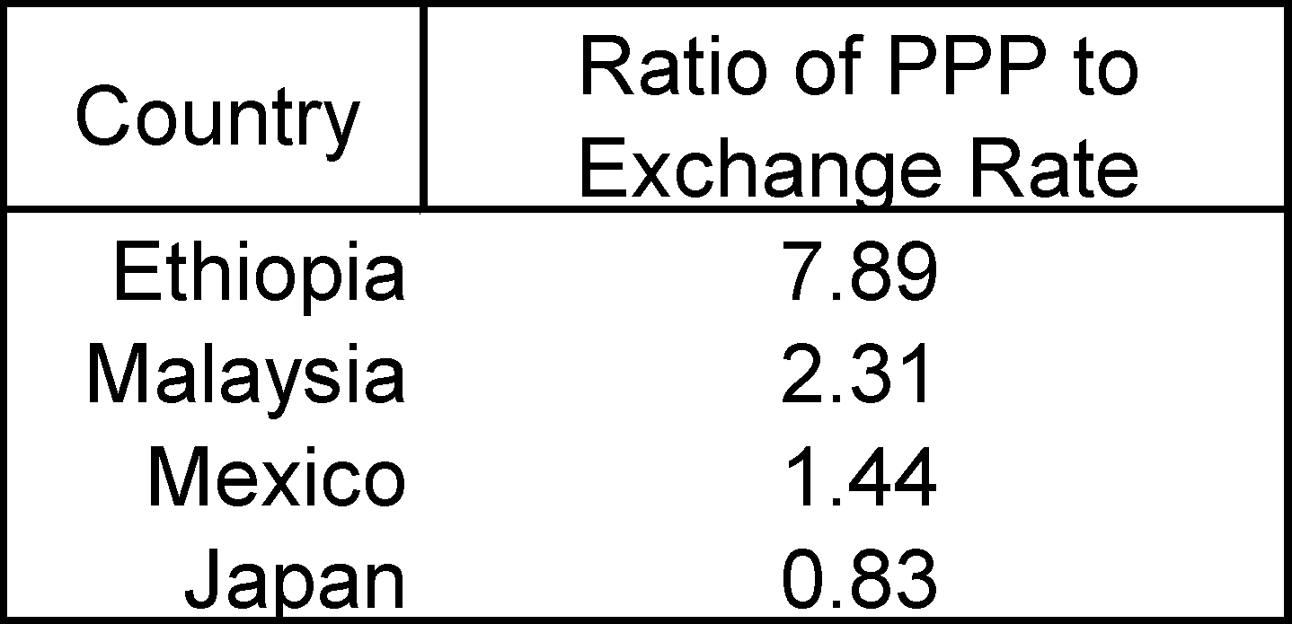
Purchasing Power Parity (PPP)
Adjusts exchange rates for purchasing power of income in different countries
Critical for comparing incomes across countries
Mexico: Exchange Rate on 1-5-2010 was 12.8 pesos/US$
But you get more for your money in Mexico (~44% more), so the PPP exchange rate is around 8.9 (=12.8/1.44)
In other words,12.8 pesos gives you not $1 but $1.44 (=12.8/8.9) in purchasing power in Mexico if you adjust for PPP!
8.9 pesos give you $1 in purchasing power parity

Slide 14
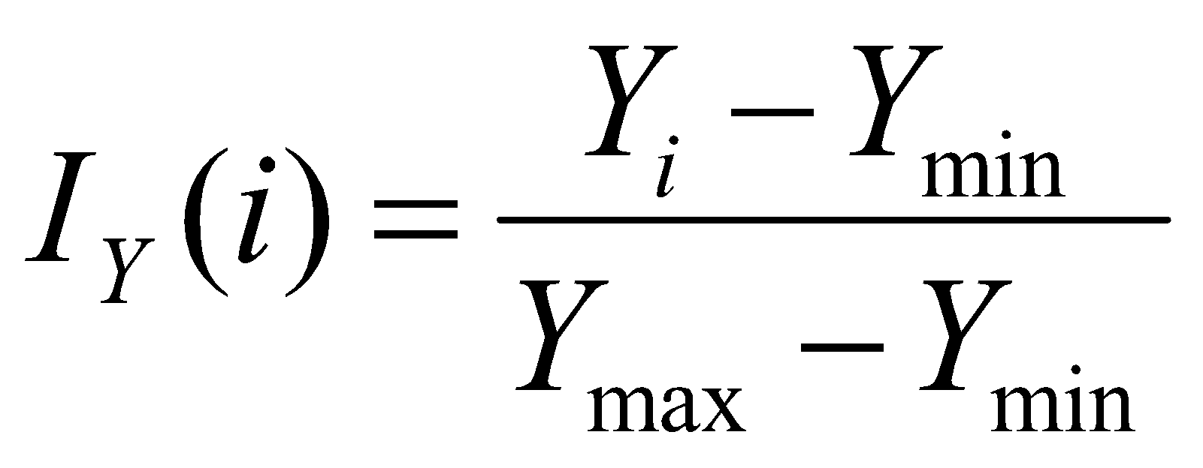
Making an Income Index
Rank index:
Income index (see index generator program):

Slide 15
Country Typologies
World Bank Standard:
Low Income (<US$765/capita in 2003)
Lower Middle ($765-$3,035)
Upper Middle ($3,035-$9,385)
High (>$9,385)
Other terms:
Third World (Pretty much out of use)
Less Developed, Developing (Commonly heard at international forums)
Emerging (Rapidly growing: China, E. European)
Industrialized (What about post-industrial OECD?)
Transitional (E. Europe, Russia, Ukraine: Controlled market -> market oriented economies)
North-South (Imprecise, but still heard sometimes)

Slide 16
What’s NOT in GDP?
GDP excludes intermediate inputs (no double counting)
Goods & services produced by citizens abroad (Mexican migrant remittances add ~$25 billion/year to Mexico’s GDP!)
Excludes goods & services not sold
Get divorced, hire a cook or nanny, and GDP goes up!
Me and Home Depot = no contractor and lower GDP
What about obesity? The environment?

Slide 17
Why Look Beyond GDP?
Robert Kennedy explained it (a few weeks before he was assassinated in Los Angeles):
www.youtube.com/watch?v=77IdKFqXbUY

Slide 18
Why Income and Economic Growth matter
In 2010, just under 1.3 billion people—22.4% of the world’s population—lived on less than $1.25 a day (PPP adjusted).
The low-income countries contained 12.5% of the world’s population but controlled less than 1% of its income, while the high income countries had a little over 16% of its population and 72% of its income.
In the poorest 10% of countries, those with GDP per capita less than $1,123, life expectancy averaged 54.4 years (compared to 80 in the richest 10%), and years of schooling averaged 3.2 years (compared to 10.5 years).

